Slide 1
Goodfellow: Chap 6
Deep Feedforward Networks
Dr. Charles Tappert
The information here, although greatly condensed, comes almost entirely from the chapter content.

Slide 2
Introduction to Part II
This part summarizes the state of modern deep learning for solving practical applications
  Powerful framework for supervised learning
  Describes core parametric function approximation
  Part II important for implementing applications
  Technologies already used heavily in industry
  Less developed aspects appear in Part III

Slide 3
Chapter 6 Sections
Introduction
1 Example: Learning XOR
2 Gradient-Based Learning
  2.1 Cost Functions
  2.2 Output Units
3 Hidden Units
  3.1 Rectified Linear Units and Their Generalizations
  3.2 Logistic Sigmoid and Hyperbolic Tangent
  3.3 Other Hidden Units
4 Architecture Design
  4.1 Universal Approximation Properties and Depth
  4.2 Other Architectural Considerations
5 Back-Propagation and Other Differentiation Algorithms

Slide 4
Chapter 6 Sections (cont)
5 Back-Propagation and Other Differentiation Algorithms
  5.1 Computational Graphs
  5.2 Chain Rule of Calculus
  5.3 Recursively Applying the Chain Rule to Obtain Backprop
  5.4 Back-Propagation Computation in Fully-Connected MLP
  5.5 Symbol-to-Symbol Derivatives
  5.6 General Back-Propagation
  5.7 Example: Back-Propagation for MLP Training
  5.8 Complications
  5.9 Differentiation outside the Deep Learning Community
6 Historical Notes

Slide 5
Introduction
Deep Feedforward Networks
  = feedforward neural networks = MLP
  The quintessential deep learning models
  Feedforward means forward flow from x to y
    Networks with feedback called recurrent networks
  Network means composed of sequence of functions
    Model has a directed acyclic graph
    Chain structure – first layer, second layer, etc.
      Length of chain is the depth of the model
  Neural because inspired by neuroscience

Slide 6
Introduction (cont)
The deep learning strategy is to learn the nonlinear input-to-output mapping
The mapping function is parameterized and an optimization algorithm finds the parameters that corresponds to a good representation
The human designer only needs to find the right general function family and not the precise right function

Slide 7
1 Example: Learning XOR
The challenge in this simple example is to fit the training set – no concern for generalization
We treat this as a regression problem using the mean squared error (MSE) loss function
We find that a linear model cannot represent the XOR function

Slide 8


Solving XOR
Original x space
Learned h space
1
1
0
0
0
1
0
1
h₁
2
x₁
Figure 6.1
(Goodfellow 2016)

Slide 9
1 Example: Learning XOR
To solve this problem, we use a model with a different feature space
Specifically, we use a simple feedforward network with one hidden layer having two units
To create the required nonlinearity, we use an activation function, the default in modern neural networks the rectified linear unit (ReLU)

Slide 10
Network Diagrams
y
y
h₁
h₂
h
W
x₁
x₂
Figure 6.2
(Goodfellow 2016)

Slide 11

Rectified Linear Activation
0
0
z
Figure 6.3
(Goodfellow 2016)

Slide 12
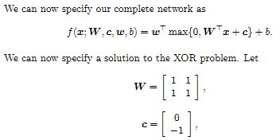

1 Example: Learning XOR

Slide 13
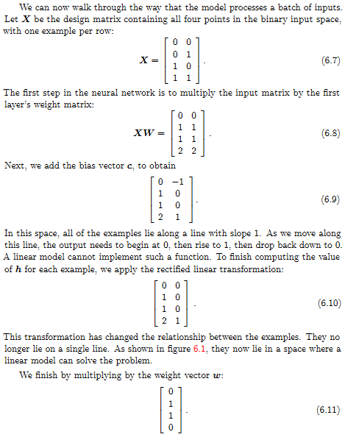
1 Example: Learning XOR

Slide 14
Solving XOR
Original x space
Learned h space
1
1
0
0
0
1
0
1
h₁
2
x₁
Figure 6.1
(Goodfellow 2016)

Slide 15
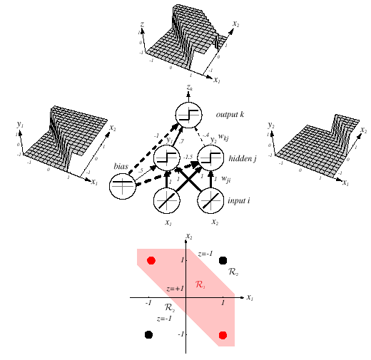
Duda, Chap 6
(other book)
Pattern Classification, Chapter 6

Slide 16
2 Gradient-Based Learning
Designing and training a neural network is not much different from training other machine learning models with gradient descent
The largest difference between the linear models we have seen so far and neural networks is that the nonlinearity of a neural network causes most interesting loss functions to become non-convex

Slide 17
2 Gradient-Based Learning
Neural networks are usually trained by using iterative, gradient-based optimizers that drive the cost function to a low value
However, for non-convex loss functions, there is no convergence guarantee

Slide 18
2.1 Cost Functions
The choice of a cost function is important
  Maximum likelihood
  Functional (a conditional statistic), such as “mean absolute error”

Slide 19
2.2 Output Units
The choice of a cost function is tightly coupled with the choice of output unit
  Linear units for Gaussian output distributions
  Sigmoid units for Bernoulli output distributions
  Softmax units for Multinoulli output distributions
  Others

Slide 20
3 Hidden Units
Choosing the type of hidden unit
  Rectified linear units (ReLU) – the default choice
    Not differentiable at z = 0
    Okay, because training will not go to gradient of 0
  Logistic sigmoid and hyperbolic tangent
  Others

Slide 21
4 Architecture Design
Overall structure of the network
  Number of layers, number of units per layer, etc.
  Layers arranged in a chain structure
  Each layer being a function of the preceding layer
Ideal architecture for a task must be found via experiment, guided by validation set error

Slide 22
4.1 Universal Approximation Properties and Depth
Universal approximation theorem
  Regardless of the function we are trying to learn, we know that a large MLP can represent it
    In fact, a single hidden layer can represent any function
  However, we are not guaranteed that the training algorithm will be able to learn that function
Learning can fail for two reasons
  Training algorithm may not find solution parameters
  Training algorithm might choose the wrong function due to overfitting

Slide 23
4.2 Other Architectural Considerations
Many architectures developed for specific tasks
  Many ways to connect a pair of layers
    Fully connected
    Fewer connections, like convolutional networks
  Deeper networks tend to generalize better

Slide 24

Better Generalization with Greater Depth
96.5
96.0
95.5
95.0
94.5
94.0
93.5
93.0
92.5
92.0
3
4
5
6
7
8
9
10 11
Layers
Figure 6.6
(Goodfellow 2016)

Slide 25

Large, Shallow Models Overfit More
97
3, convolutional
3, fully connected
11, convolutional
96
95
94
93
92
91
Layers
0.0
0.2
0.4 0.6
Number of parameters
0.8
1.0
⇥10⁸
Shallow models tend to overfit around 20 million parameters, deep ones benefit with 60 million
Figure 6.7
(Goodfellow 2016)

Slide 26
5 Back-Propagation and Other Differentiation Algorithms
When we accept an input x and produce an output y, information flows forward in network
During training, the back-propagation algorithm allows information from the cost to flow backward through the network in order to compute the gradient
The gradient is then used to perform training, usually through stochastic gradient descent

Slide 27
5.1 Computational Graphs
Useful to have a computational graph language
Operations are used to formalize the graphs

Slide 28
Computation Graphs
yˆ
z
_{u}(1)
_{u}(2)
+
dot
X
y
X
W
b
(a)
(b)
H
_{u}(2)
_{u}(3)
relu
sum
x
_{U} (1)
_{U} (2)
yˆ
_{u}(1)
+
sqr
matmul
dot
X
W
b
X
W
λ
(c)
Figure 6.8
(d)
(Goodfellow 2016)

Slide 29

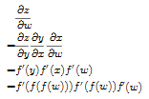
5.2-10 Chain Rule and
Partial Derivatives

Slide 30
Symbol-to-Symbol Diﬀerentiation
z
z
Figure 6.10
f
f
_{f} '
dz dy
y
y
f
f
_{f} '
x
x
x
dy
dz
dx
dx
f
f
_{f} '
x
w
dx
dz
w
dw
dw
(Goodfellow 2016)

Slide 31
6 Historical Notes
Leibniz (17th century) – derivative chain rule
Rosenblatt (late 1950s) – Perceptron learning
Minsky & Papert (1969) – critique of Perceptrons caused 15-year “AI winter”
Rumelhart, et al. (1986) – first successful experiments with back-propagation
  Revived neural network research, peaked early 1990s
2006 – began modern deep learning era

